Slide 1
Online Food Delivery System
Guide
Prof. Tejas Joshi

Slide 2
Team Members
Sushant Padale
Suraj Sawant
Anil Rode

Slide 3
Introduction :
In today’s age of fast food and take-out many restaurants have chosen to focus on quick Preparation & speed delivery.
The system also allows to quickly & easily manage an online menu which customers can browse & use to place orders with just few clicks.

Slide 4
Scope
Easy to use for customer.
Security Provided.
Lots of time gets saved.
Easy backup of data.
User Friendly.
Speed delivery.
Notes:
.

Slide 5

Software Requirement
Spring Tool Suite/Eclipse
Browser Chrome or others
Java JDK
JSP(Java Server Pages)
MYSQL
Apache Tomcat

Slide 6
Hardware Requirement
Intel core I3 Processor or above
RAM 2GB and above
Operating System
Any Operating System.

Slide 7
Modules
Order
Food Item
Sales
Delivery
Payment
Customer

Slide 8
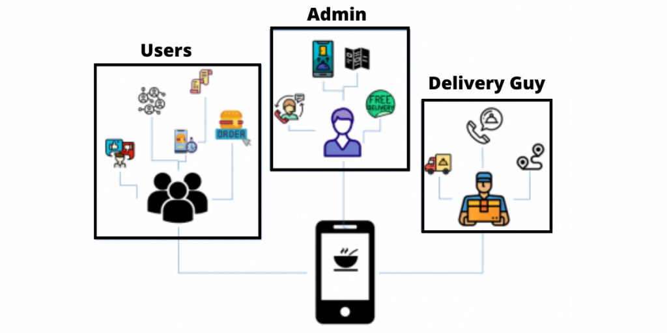
working process

Slide 9
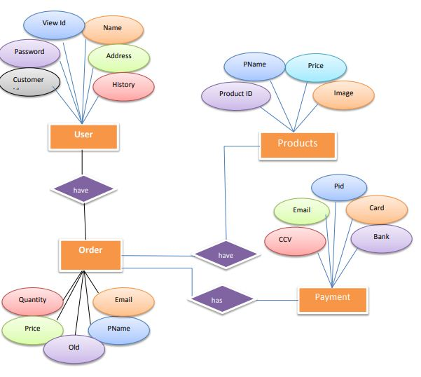
ER Diagrams

Slide 10
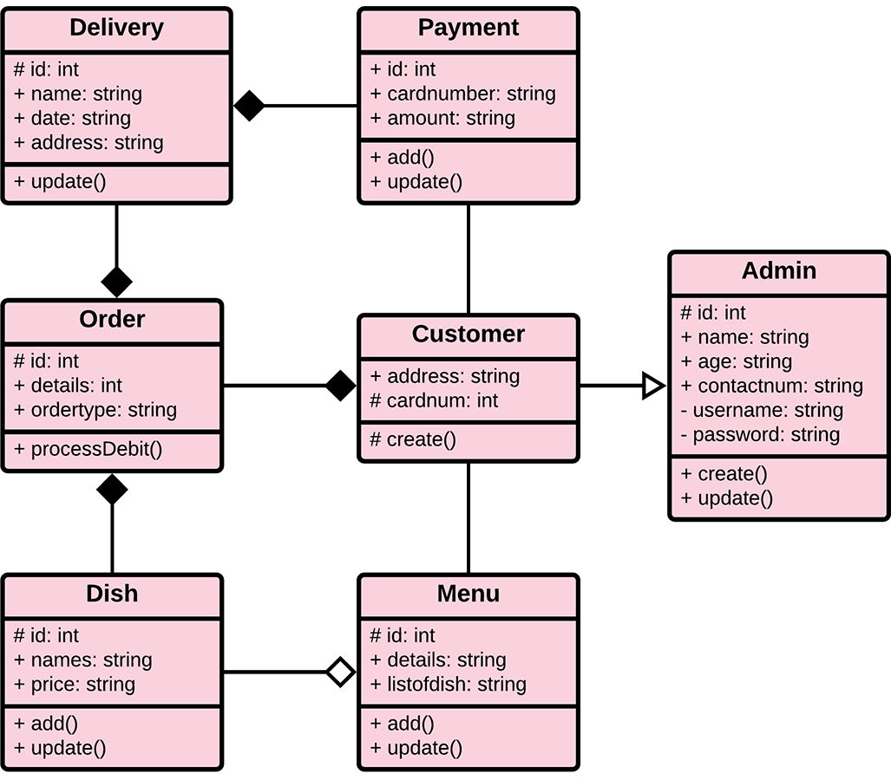
Database

Slide 11
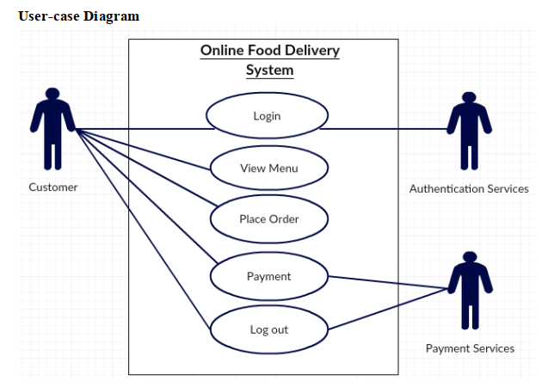

Slide 12
Thank You !

